Slide 1
Sacred Manhood and Male Rites of Passage: From Trauma to Healing
Culturally Rooted, Trauma Informed, Healing Centered Teachings
Jerry Tello
The National Compadres Network

Slide 2
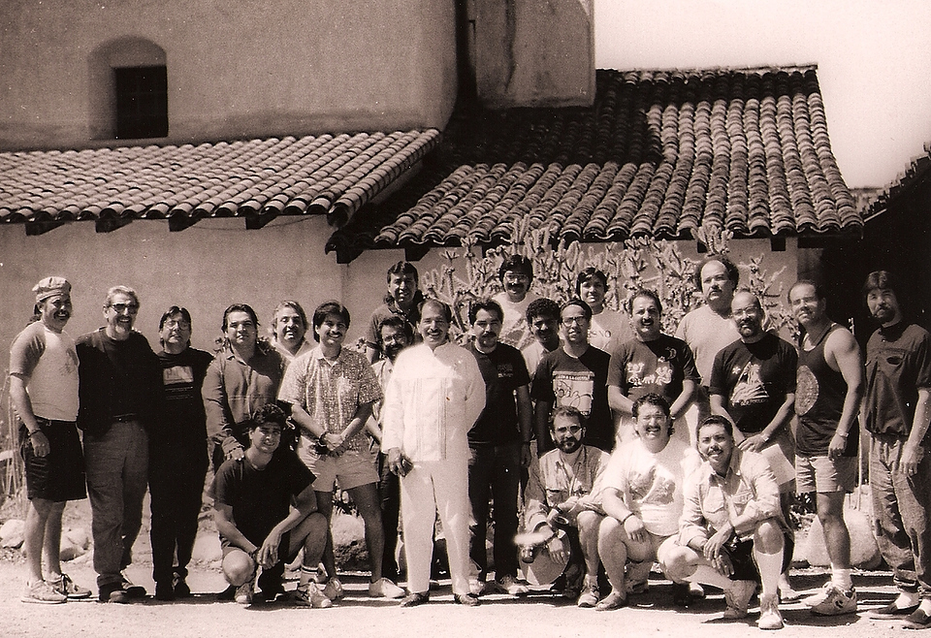
Recapturing and Reclaiming our True Spirit Circulo de Hombres - 1988 Men’s Retreat

Slide 3
All families want to raise healthy children, including boys, to grow up to be healthy, successful, respectful members of their family and community.
For immigrant, indigenous and Boys of color, historical trauma, present day racism and systems inequities cause additional challenges.

Slide 4
For many Men and Boys we must recognizes that they Carry their Ancestors Burdens, Trauma and their Tears

Slide 5
The Bridge – El Puente

Slide 6
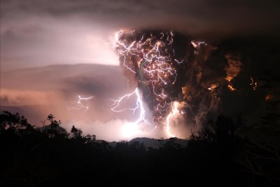
Internalized Oppression The result being that Young and older men being Stuck on the bridge of life DISCONNECTED from their True honorableValues resulting in them adopting oppressive, patriarchal ways of surviving

Slide 7
COLONIZATION Spirit Break Process
Confusion- (withdrawal)
Anger- (shame)
Hate- (blame)
Self-hate- (self sabotaging)
Rage (reactive/addictive)

Slide 8
Mental Health Issues
Confusion- (depression)
Anger- (anxiety issues)
Hate- (Impulsive/reactive)
Self-hate- (self sabotaging)
Rage (addictive/suicidal)

Slide 9
So Rites of Passage and Healing of boys and men requires regrounding them in teachings of SACRED MANHOOD and guiding them to shed and decolonize the wounded ways.

Slide 10
Systemic Inequity Culturally Based Health and Healing is Interconnected to All Our Relations and Experiences. The systems, and it’s service providers either support or contribute to the healthy development or the imbalance in our lives.
Notes:
Globe grapjhic

Slide 11
Benefits include ability to:
Break Cycles of Disconnection
Heal generations of Pain
Rebuild valued traditions
Recover Sacred manhood
When Culture and Healing are at the base of learning Men and Boys DO BETTER

Slide 12
: Transformational Rites of Passage, Healing and Restoration La Cultura Cura

Slide 13
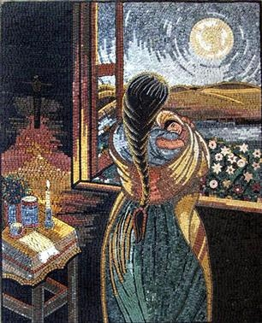
GROUNDED TEACHINGS
You are WANTED a Blessing (DIGNITY)
You have a SACRED PURPOSE (RESPECT)
You have culturally based teachings/values), and family, community TEACHERS (Rites of Passage) to guide you (TRUST)
You have SAFE, COMPASSIONATE people and SECURE places to learn, heal, grow. (LOVE).

Slide 14
RITES OF PASSAGE
Regrounding in positive traditions & practices
Healthy rites of passages
Life Skill Development
Healing and Transformation
Extended kinship, generational support.

Slide 15
RECLAIMING THE NARRATIVE
True Manhood is grounded in incorporating the 4 dimentions of Manhood ( Masculine, Feminine, Childhood and Elder) and rooted First and Foremost
in the Respect of Women, Children
and All Our Relations

Slide 16
EL HOMBRE NOBLE (A Noble Man)
IS A PERSON OF THEIR WORD
HAS A SENSE OF RESPONSIBILITY FOR THEIR
OWN WELL-BEING AND THAT OF OTHERS IN
THEIR CIRCLE
REJECTS ANY FORM OF ABUSE; PHYSICAL, EMOTIONAL, MENTAL, OR SPIRITUAL, TO THEMSELVES OR OTHERS
TAKES TIME TO PRAY AND INCLUDE CEREMONY
IN THEIR LIFE
IS SENSATIVE AND UNDERSTANDING
IS LIKE A MIRROR, REFLECTING SUPPORT AND CLARITY TO ONE ANOTHER
LIVES THESE VALUES HONESTLY AND WITH LOVE

Slide 17
THE DEFENITION OF the True MACHO
HE WHO IS DIGNIFIED
HE WHO IS A PROTECTOR
HE WHO IS RESPONSIBLE
HE WHO IS NURTURING
HE WHO IS SPIRITUAL
HE WHO IS FAITHFUL
HE WHO IS RESPECTFUL
HE WHO IS FRIENDLY
HE WHO IS CARING
HE WHO IS SENSITIVE
HE WHO IS TRUSTWORTHY
HE WHO PROVIDES

Slide 18
Men’s Extended Kinship Support
You are connected to us and We commit to walk with you
Notes:
Globe grapjhic

Slide 19
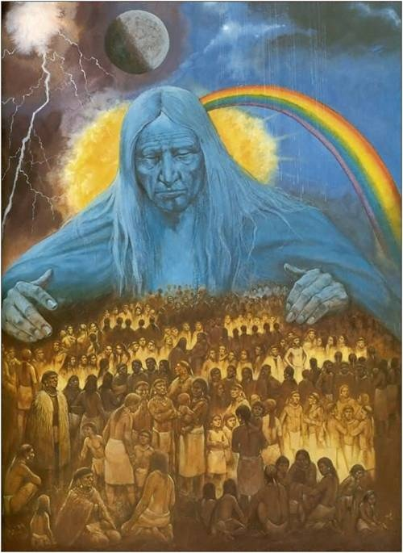
SYSTEMS ROLE …
Develop Policies and procedures that support culturally based positive rites of passage learning.
Fund and support Culturally based, trauma informed, healing centered curricula and programs for Men.

Slide 20
NCN Training and T.A.
ORG. father/Male Friendly Policy and Program Development
Trauma Informed, Healing centered staff training
Fatherhood, Teen Fatherhood and Rites of Passage
Curricula Training
*Respect and Read Campaign ( DV Prevention and Literacy, Father Engagement efforts
Generational Kinship and Support Circles

Slide 21
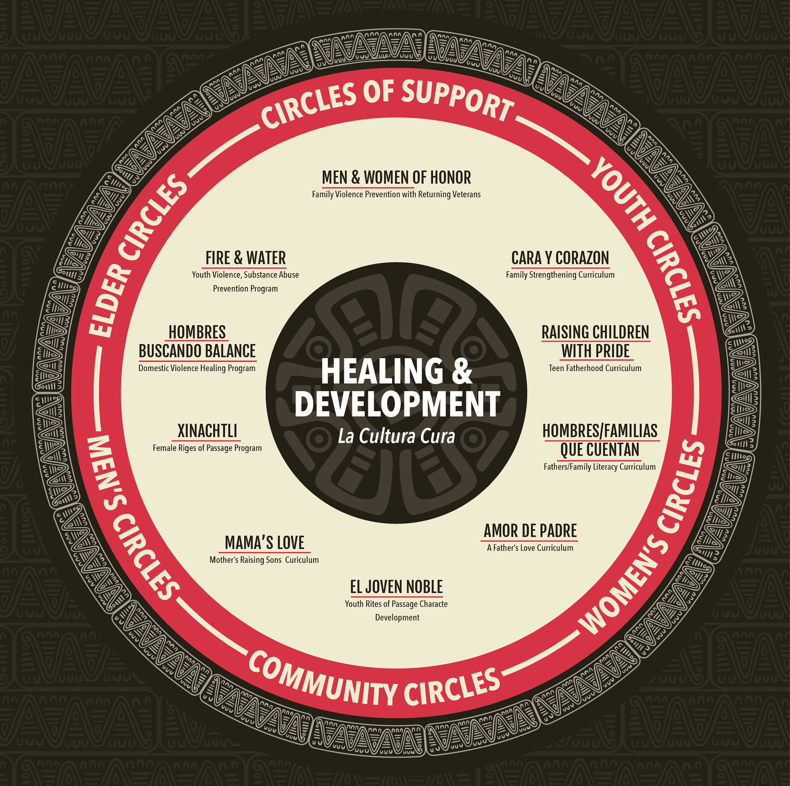
CURRICULUM
EL Joven Noble
- Character Development & Rites of Passage
Raising Children with PRIDE
- Fatherhood
Hombres Buscando Balance
- Domestic Violence Healing
Circle Keeper
- Healing & Support Circles

Slide 22
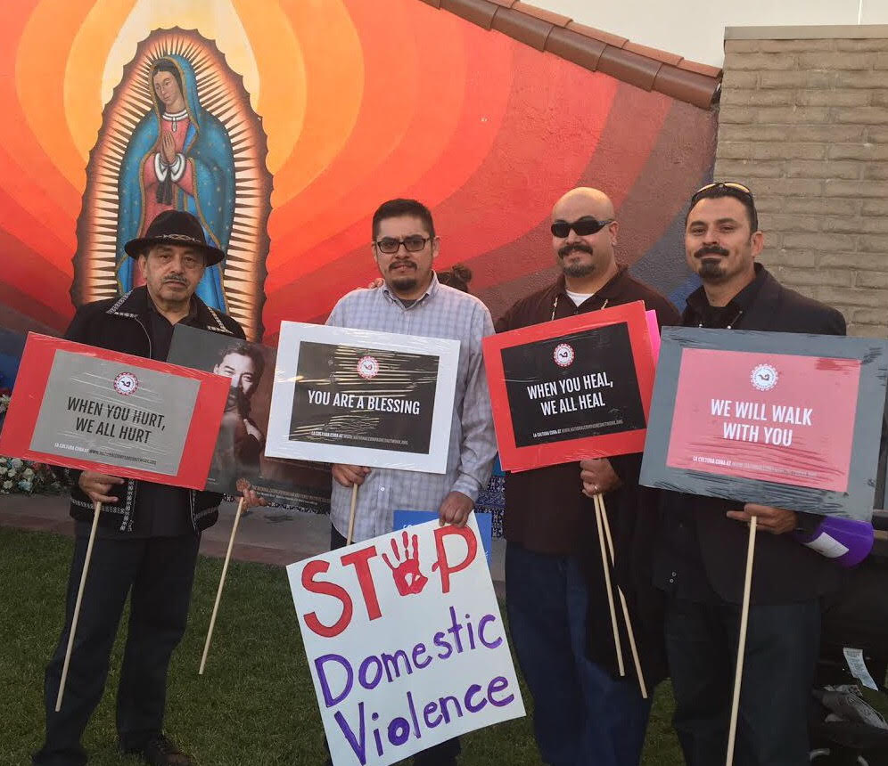
A PLEDGE FOR FATHERHOOD & MALE RESPONSIBILITY
YOUTH PLEDGE
- Be a person that understands that my most prized possession is the value of my word and through my actions be true to my word.
- Recognize that my identity as a young person is not about violence or taking advantage of others but of being caring and responsible.
FATHERHOOD PLEDGE
- Will demonstrate how to speak out against injustice and oppression even when it is more comfortable to be silent.
- Be a man that teaches children the value of being true to their word and reflects this value in his interactions with his children and all his relations.

Slide 23
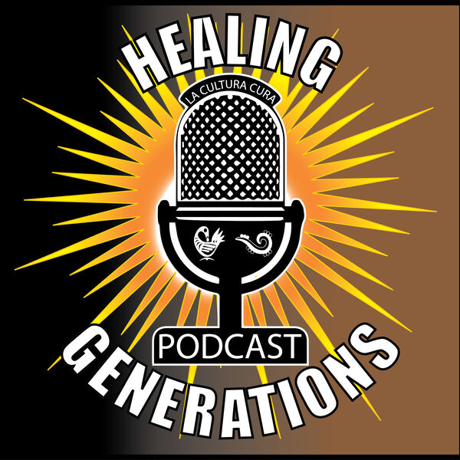
Please follow us and Subscribe
VISIT OUR WEB SITE AT WWW.NATIONALCOMPADRESNETWORK.ORG •
FOLLOW US ON www.facebook.com , Instagram (@la.cultura.cura), and Twitter (@laculturacura)
•
Listen to us on our HEALING GENERATIONS PODCAST on all major podcast platforms
Notes:
Ozzie will cover

Slide 24
FOR FURTHER INFORMATION, CONTACT
NATIONALCOMPADRESNETWORK.ORG
(408) 484-4191
jerrytello.com

